Slide 1
Prerequisite knowledge (see Amino Acids models)
Amino Acid Summary
There are 20 amino acids used in proteins.
Shared features:
  All are L-isomers (except glycine)
  Amphoteric (can act as acid or base)
  Each has an amino, carboxylic acid, and side chain group (except proline)
  Each amino acid can be represented multiple ways, but the space its electrons take up is always the same.
  Unique features:
    Cysteine can form disulfide bonds
    Tyrosine and Tryptophan absorb light at 280 nm well
    Serine, Threonine, Tyrosine have hydroxyl groups which can be modified to activate/inactivate protein function
    Glycine and proline each have unique flexibility or lack of it.
  Amino acids can be titrated, and their charge state is important.
  Amino acids form peptide bonds.
    Amino acid 3D shapes constrain bond angles

Slide 2
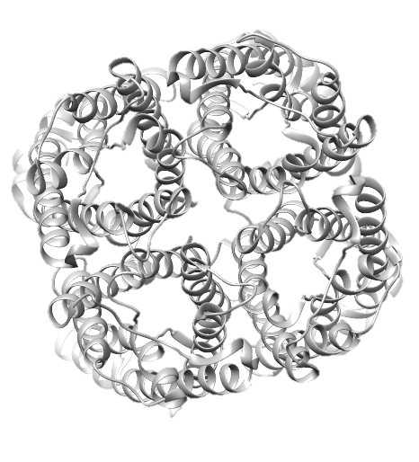
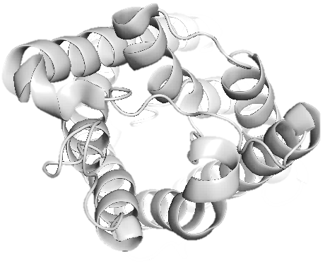
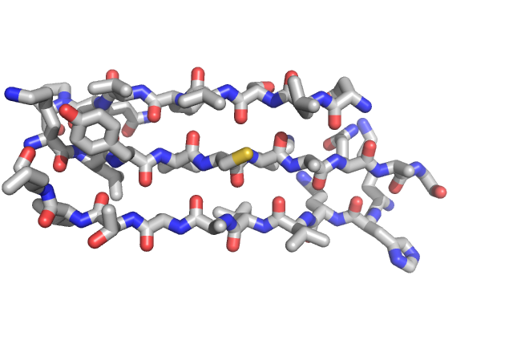
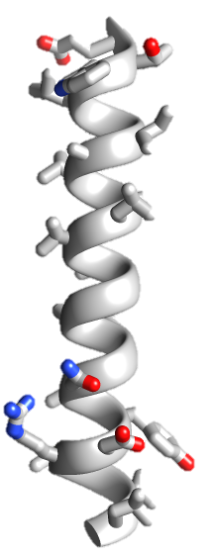
From chemicals to chemical machines
Please sit in groups of 3!
M
E
T
H
D
N
M
A
D
S
N
S
E
How does the shape and order of amino acids influence the structure and function of the final protein?

Slide 3
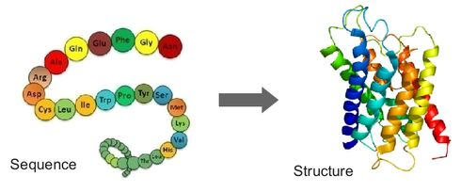
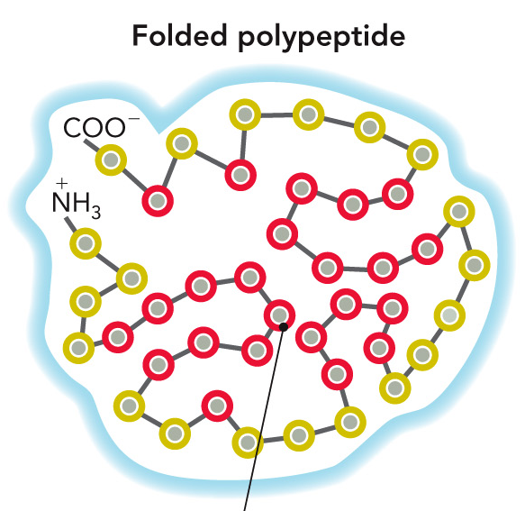
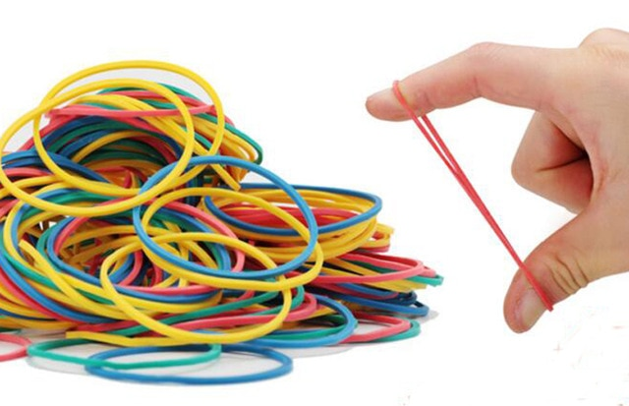
Today:
How amino acids of a protein interact to make protein structures
How proteins interact with solvent
Why protein flexibility is important
How protein regions can be made more stable or more flexible

Slide 4
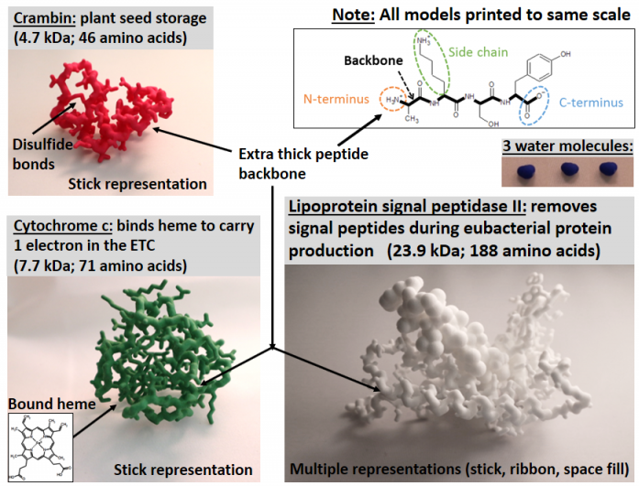

Slide 5
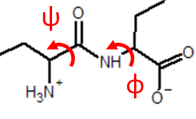
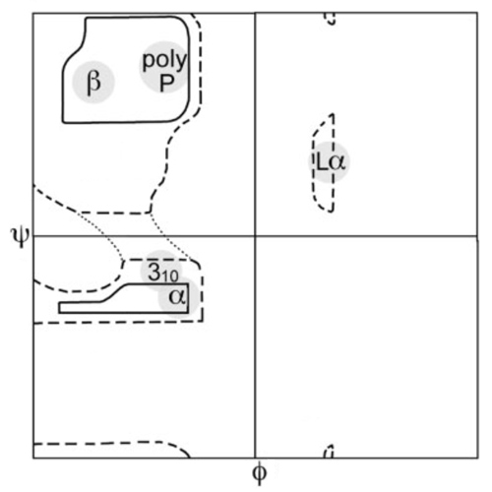
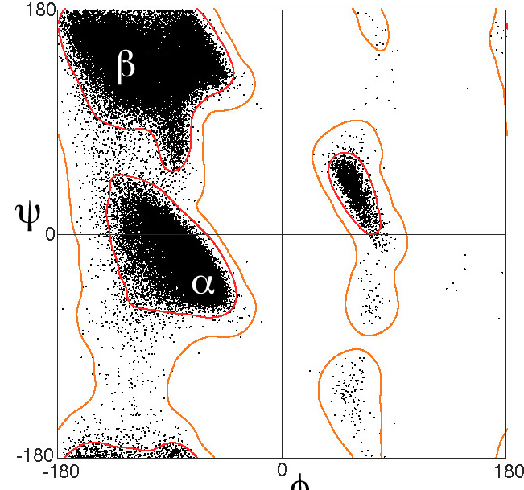
Secondary Structures
Ramachandran predicted all possible angles, and suggested some simple repeated structures
Predicted
Real
81,234 non-Gly, non-Pro, non-prePro residue angles from 500 high resolution protein structures
Antiparallel β sheets
Parallel β sheets
Left-handed α helix
ψ
Right-handed α helix
φ
Lovell et al. 2003
Notes:
Lovell, S.C.; Davis, I.W.; Arendall, W.B.; De Bakker, P.I.W.; Word, J.M.; Prisant, M.G.; Richardson, J.S.; Richardson, D.C. (2003). "Structure validation by Cα geometry: ϕ,ψ and Cβ deviation". Proteins: Structure, Function, and Genetics 50 (3): 437–50.

Slide 6
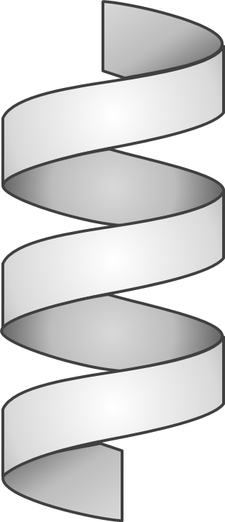
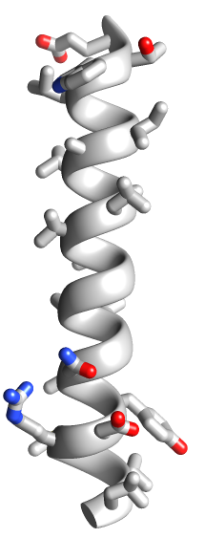
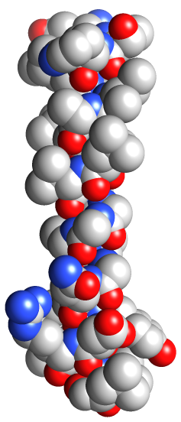
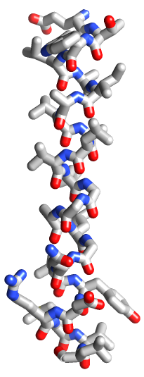
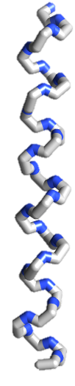
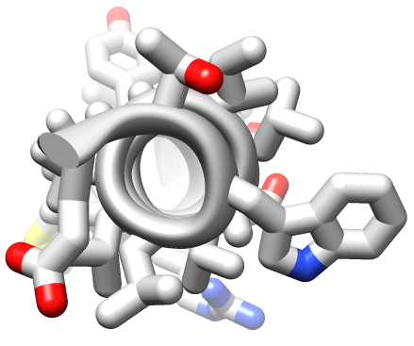
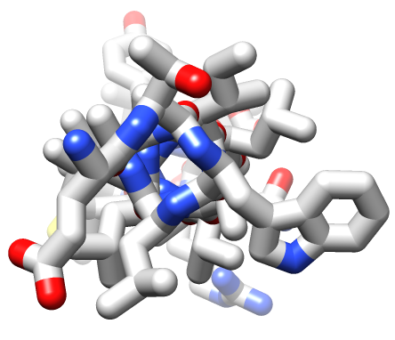
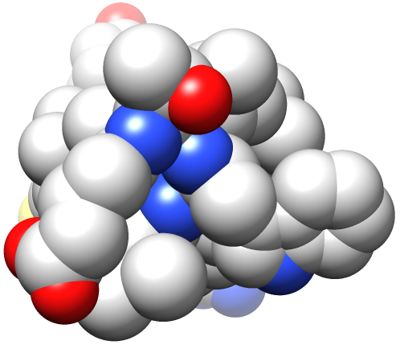
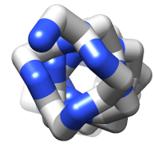
The α Helix
Polypeptide rotates around a central axis
Complete turn every 3.6 amino acids
Oxygen
Nitrogen
Carbon
8
1
12
15
5
4
16
11
9
18
2
7
13
14
3
17
6
10

Slide 7
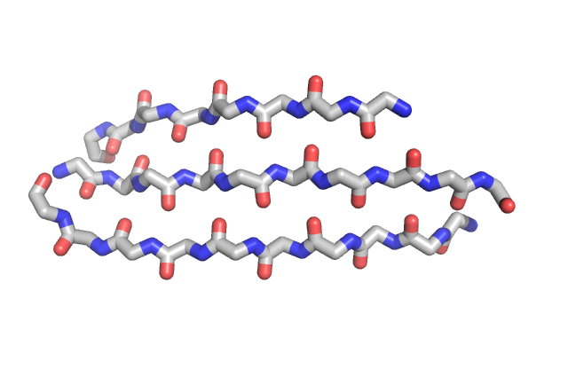
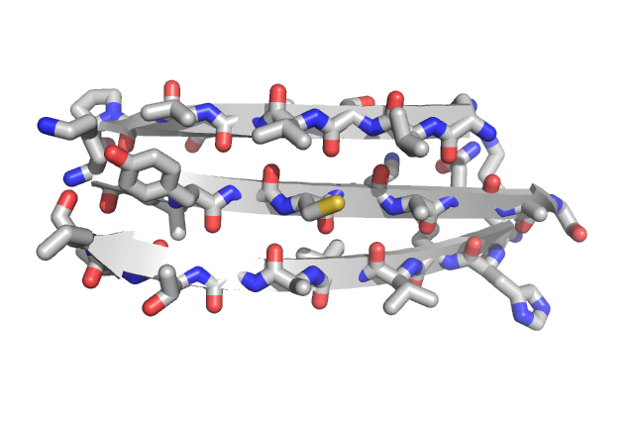
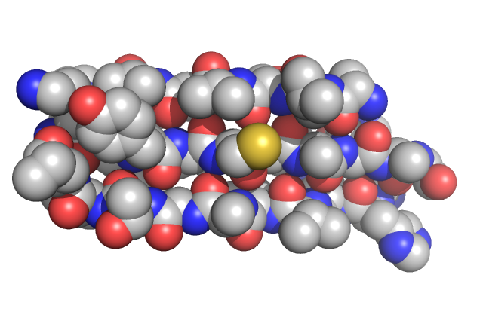
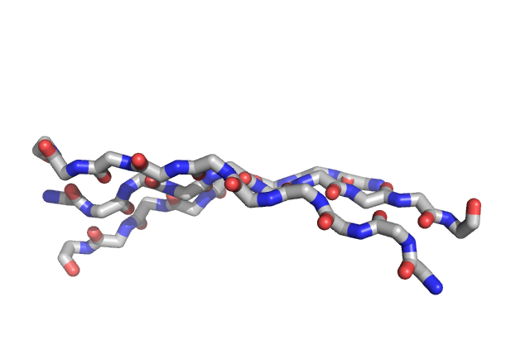
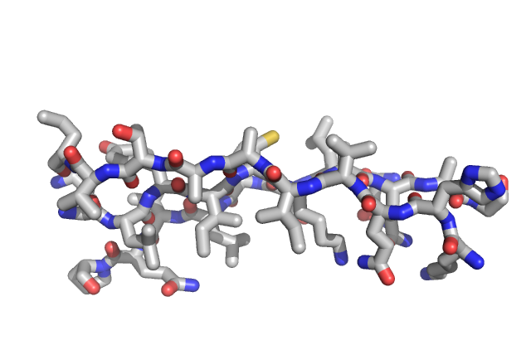
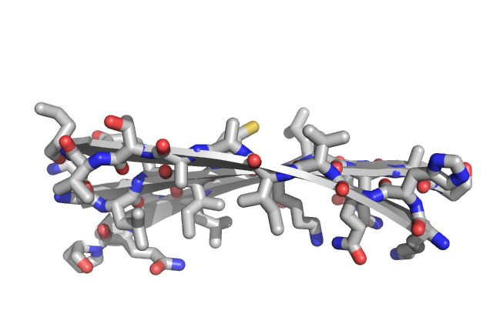
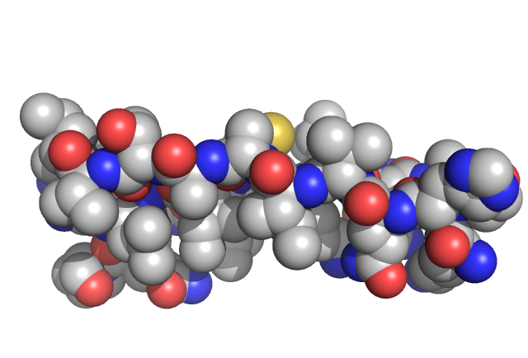
The β sheet
Evenly spaced, interacting strands
β strands
β sheet
Oxygen
Nitrogen
Carbon
Sulfur
Can be made of any number of strands >2

Slide 8
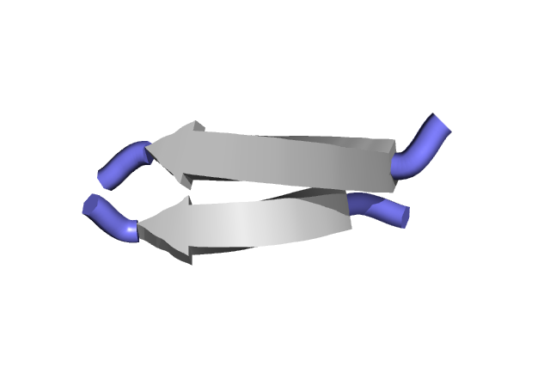
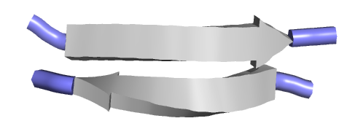
Parallel and Antiparallel β Sheets
Parallel
Anti-Parallel
N-terminus
N-terminus
C-terminus
C-terminus
N-terminus
C-terminus
C-terminus
N-terminus
N- and C-termini on the same side
Weaker interaction (bent)
N- and C- termini on opposite sides
Stronger interaction (straight)

Slide 9
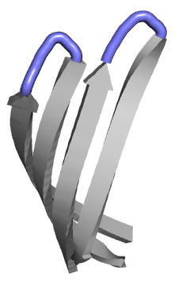
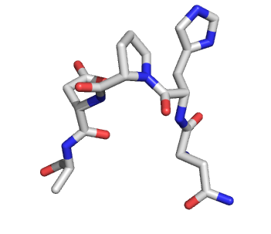
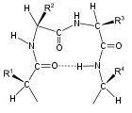
β Turns
β-turn
β-turn
Pro
Gly
2
3
1
4
β-turn
β turns are a 180° turn using four amino acids
The turn is stabilized by interactions between amino acid 1 to amino acid 4.
Proline in position 2 or glycine in position 3 are common in β turns
Notes:
FIGURE 4-7 Structures of β turns. (a) Type I and type II β turns are most common; type I turns occur more than twice as frequently as type II. Type II β turns usually have Gly as the third residue. Note the hydrogen bond between the peptide groups of the first and fourth residues of the bends. (Individual amino acid residues are framed by large blue circles.)

Slide 10
Clicker Question
What secondary structures did your group identify?
Alpha helices
Beta sheets
Beta turns
A and B
A, B and C

Slide 11
2709L

Slide 12
Clicker Question
What part of the amino acids in a β-strand interacts with another strand in the same sheet?
A. Backbones
B. Side chains
C. C_{α}
D. α_{C}
E. A and B

Slide 13
Clicker Question
What type of weak interaction binds the β-strands into a β-sheet?
A. Covalent bonds
B. Ionic bonds
C. Salt bridges
D. Hydrogen bonds
E. Van der Waal’s

Slide 14
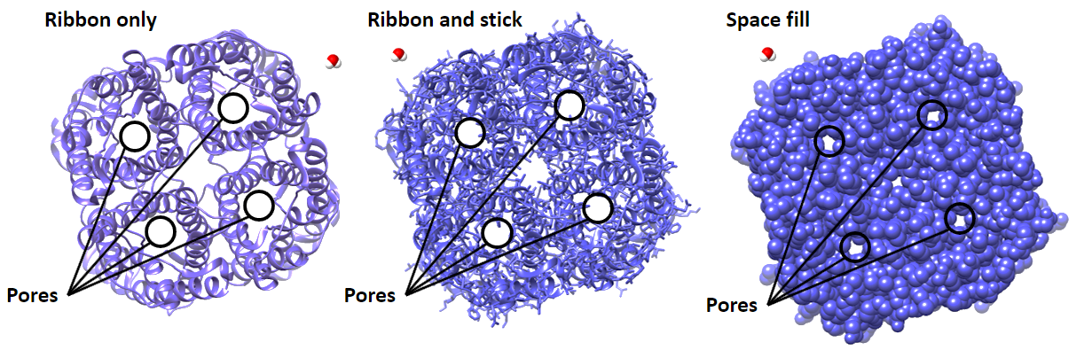
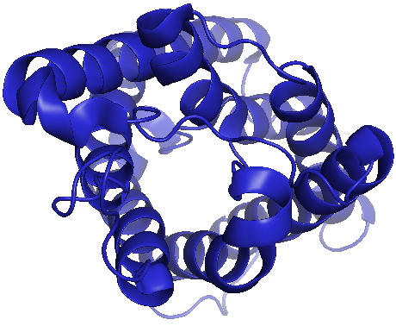
Tertiary and Quaternary Structure
Tertiary structure is the 3D structure of a single peptide chain.
(Includes all the secondary structures and their folding pattern.)

Slide 15
Tertiary and Quaternary Structure
Tertiary structure is the 3D structure of a single peptide chain.
(Includes all the secondary structures and their folding pattern.)
What keeps the helices together?

Slide 16
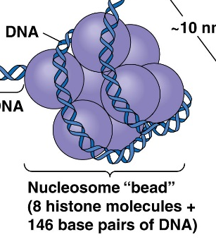
Quaternary Structure
Multiple polypeptides can connect in “quaternary structure”
Quaternary structure polypeptides interact identically to tertiary structure.
Why have multiple polypeptides?
Combine properties from individual polypeptides
Monomer
Dimer
Trimer
Tetramer
Octamer
Two flavors: homo-oligomers and hetero-oligomers
Homo- = same
Hetero- = different
Monomer
Heterodimer
Heterotrimers
Heterotetramers

Slide 17
2213H

Slide 18
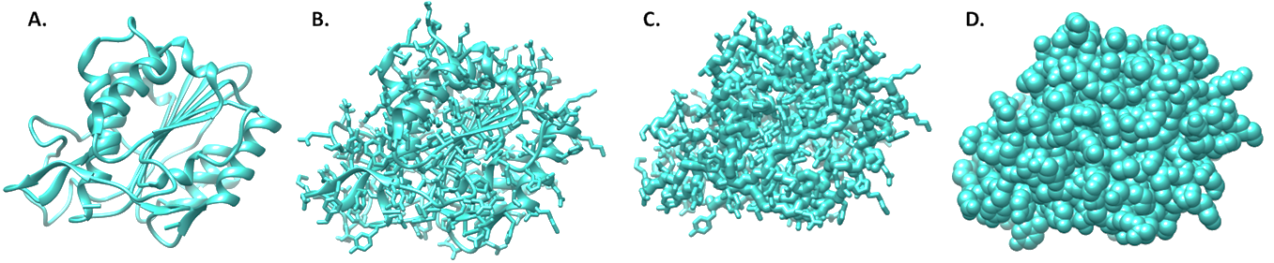
Clicker Question
The following are different representations of the same protein.
Which takes up more space in real life?
A
B
E. They all take up the same space
C
D

Slide 19
Clicker Question
Where in the primary sequence are the amino acids that interact with each other in the tertiary structure?
Close to each other
Distant from each other
Both A and B.

Slide 20
2627A

Slide 21
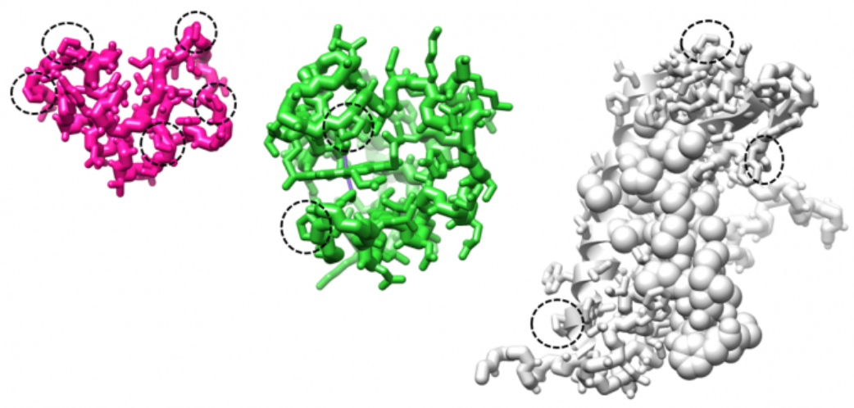
Proline case study
Secondary structures have repeated backbone amino acid structures.
But some amino acids are less flexible!

Slide 22
Clicker Question
Are the proline residues mostly located in or out of secondary structures?
In
Out
On the edge

Slide 23
Clicker Question
Describe the shape of the proline backbones you found. Are they:
Always similar
Usually different

Slide 24
Secondary Structure Review
There are several defined types of secondary structures. The four you need to know are: right-hand α-helix, antiparallel β-sheet, parallel β-sheet, and β-turn.
Secondary structures are stabilized by repeated H-bonds between the peptide backbone (not side-chains).
    Thus, proline and glycine, which have different conformations of the peptide backbone are not favored in helices or sheets. However, they form turns well.
Secondary structure elements usually form quickly after primary structure is synthesized.

Slide 25
Tertiary Structure Summary
Secondary structure elements (helices, sheets, turns) combine via side-chain weak interactions
  hydrophobic interaction
  van der Waals interaction
  hydrogen bonding
  electrostatic interaction
To make tertiary structure. The final tertiary structure is organized so that it exists at an energy minimum with its surroundings.

Slide 26
Protein Structure Summary:
M
E
T
H
D
Quaternary
Structure
N
M
Tertiary
Structure
A
D
Individual polypeptides group together to enhance function.
They can make macromolecular structures (hair, nails, etc.)
Or they can enhance each other’s abilities in another way.
S
N
Secondary structure elements are arranged in the lowest energy format.
Side chain chemistry drives tertiary structure, particularly the need to bury hydrophobic residues.
S
E
Secondary
Structure
Primary Structure
C_{α} rotations are limited by steric hindrance.
Common secondary structures reduce energy by hydrogen bonding between backbone carbonyls and amines.
Peptide bonds are planar.
Rotation is allowed around C_{α}.

Slide 27
Class analogy of protein structure
Each student represents an amino acid. Each right hand represents an alpha-carboxyl group, and each left hand an alpha-amino group, and the head the R group.
By joining right hands to left hands, the class will form a polypeptide. Each set of joined hands represents peptide bonds. This is like primary structure.
If one then takes students and "attract" them to other students 4 "bonds" away, this structure will then fold into a secondary structure; namely the alpha-helix. If the students were put into lines and were attracted to respective students in another line, they would form a beta-sheet.
The heads (R groups), vary in personality (polarity). Given sufficient time, the people who are more compatible will then gather together, similarly to how hydrophobic areas will usually gather together. This makes up the tertiary structure.
Now add in a different class, the people from the new class would have their own tertiary structure, these new people will then come in and react with the original class to form quaternary structures.

