Slide 1
Prerequisite Knowledge
The same day I do this module, I cover:
Amino acid structures and groupings
Peptide bond formation
N- and C-termini

Slide 2
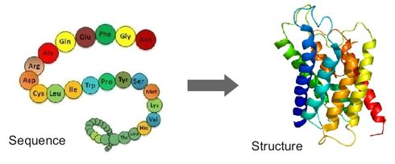
Amino Acids – an introduction to Proteins
Over the next couple of weeks we will look at the how proteins are made:
Primary structure (string of amino acids)
Secondary structure (common, stabilized 3D features)
Tertiary structure (entire 3D folding pattern)
Quaternary structure (more than one amino acid chain)

Slide 3
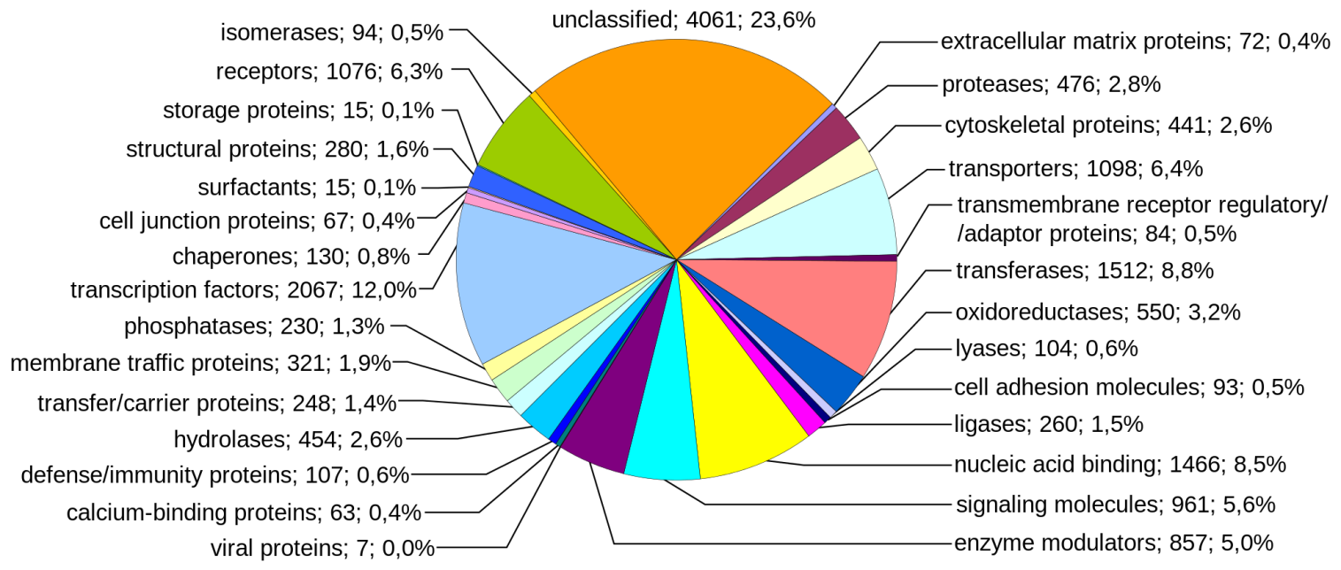
What are proteins good for?
Proteins grouped by function from the Human Genome
Just about everything!
Proteins control almost every action and reaction—including thought!

Slide 4
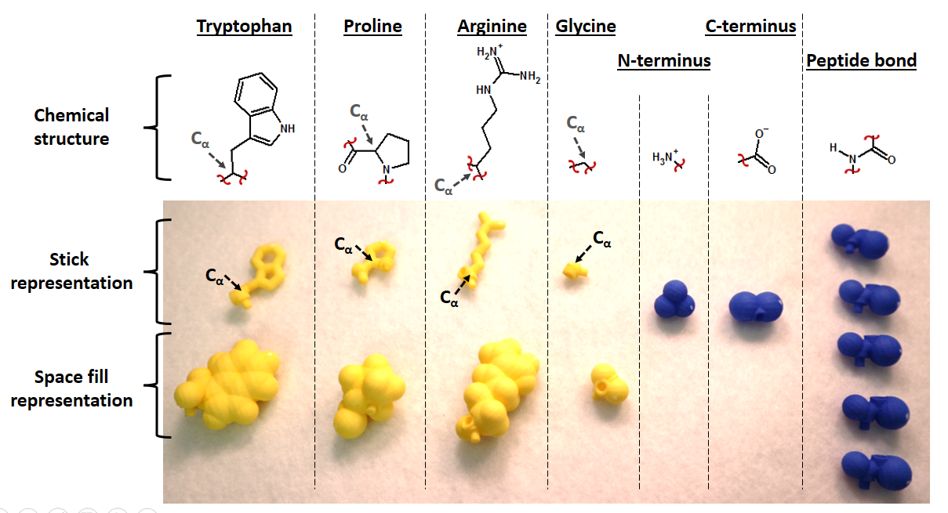
Connecting Amino Acids Activity
If doing an electronic version of the activity, provide link here

Slide 5
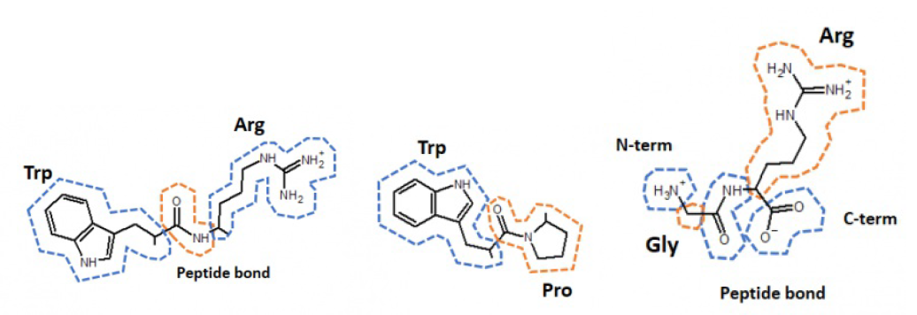
Amino Acid Clicker Question:
Which one of these dipeptides will have the greatest rotation around the C_{α}s?
A
B
C
“Peptide backbone”

Slide 6
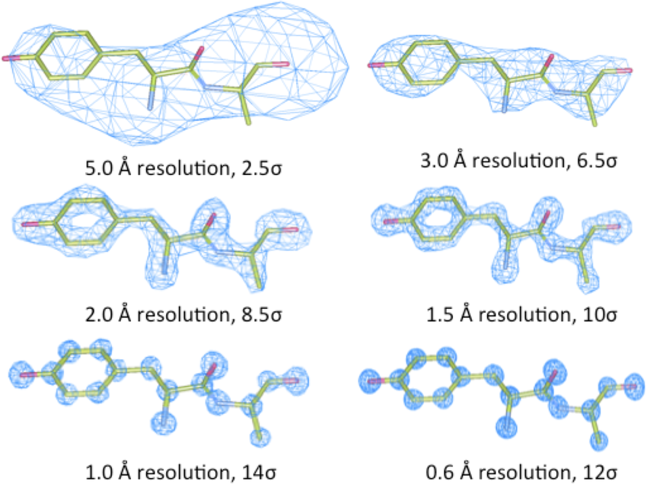
X-ray crystallography

Slide 7
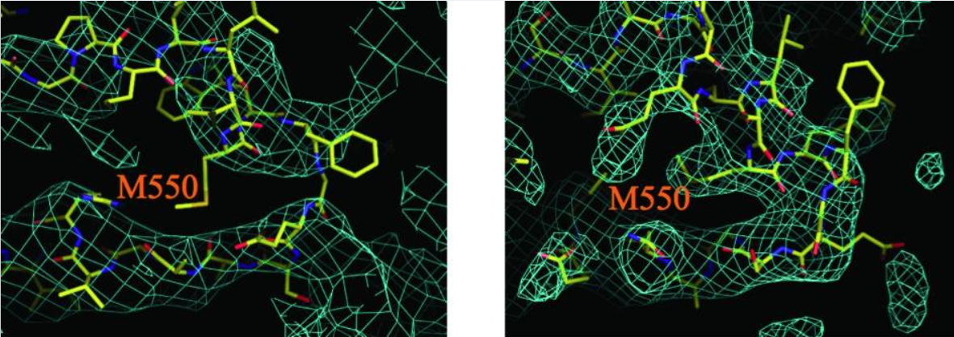
Evaluating our trust of crystal structures
1308B (Code to continue)
Brunger AT, DeLaBarre B, Davies JM, Weis WI. X-ray structure determination at low resolution. Acta Crystallographica Section D: Biological Crystallography. 2009;65(Pt 2):128-133. doi:10.1107/S0907444908043795.

Slide 8
Amino Acid Summary
There are 20 amino acids used in proteins.
Shared features:
All are L-isomers (except glycine)
Amphoteric (can act as acid or base)
Each has an amino, carboxylic acid, and side chain group (except proline)
Each amino acid can be represented multiple ways, but the space its electrons take up is always the same.
Unique features:
Cysteine can form disulfide bonds
Tyrosine and Tryptophan absorb light at 280 nm well
Serine, Threonine, Tyrosine have hydroxyl groups which can be modified to activate/inactivate protein function
Glycine and proline each have unique flexibility or lack of it.
Amino acids can be titrated, and their charge state is important.
Amino acid shapes constrain bond angles.

Slide 9
Next Lecture:
See how amino acids joined in peptides form repeated elements in protein structure.
Look at determinants of a protein’s final structure.

