Slide 1

Enzyme regulation and mechanisms inside the cell

Slide 2



Prerequisite Knowledge:
How do enzymes increase reaction rates?
Reducing the transition state energy (i.e., barrier to instability) by using binding energy to stabilize the transition state.
Provide an alternate path for product formation.
Reduce entropy by binding and orienting multiple substrates.
$$−∆G$$
$$+∆G$$
Stronger binding, would release energy
High energy (transition state), requires energy
Strain, cage effect, acid-base, covalent, metal ion

Slide 3
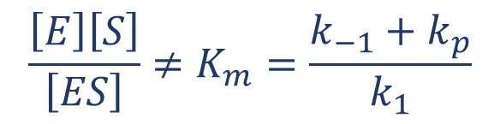
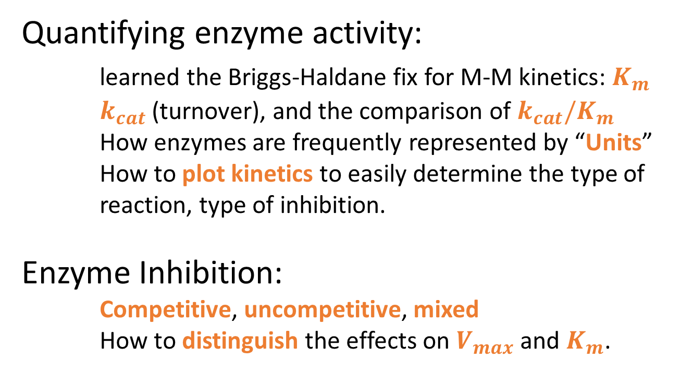
Prerequisite Knowledge:
Quantifying enzyme activity:
learned the Briggs-Haldane fix for M-M kinetics: $K_{m}$
  $k_{cat}$ (turnover), and the comparison of $k_{cat}/K_{m}$
  How enzymes are frequently represented by “Units”
  How to plot kinetics to easily determine the type of reaction, type of inhibition.
  Enzyme Inhibition:
      Competitive, uncompetitive, mixed
      How to distinguish the effects on $V_{max}$ and $K_{m}$.
$$\frac{\left[E\right]\left[S\right]}{\left[ES\right]}≠K_{m}=\frac{k_{−1}+k_{p}}{k_{1}}$$
[I]
[I]
Competitive
Uncompetitive

Slide 4
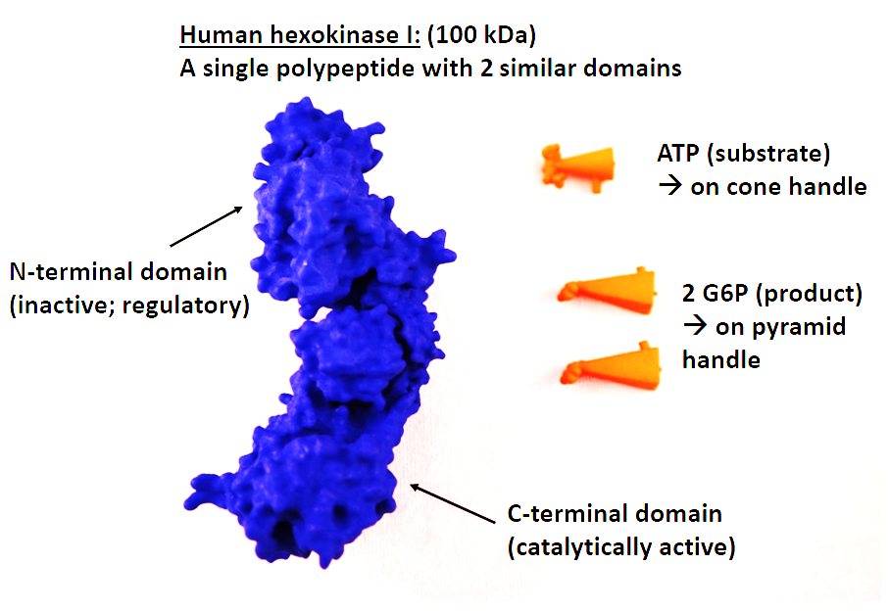
Today: Enzyme mechanism:
Internal regulation of enzymes (in class activity)
6 classes of enzymes
1. Oxidoreductase | Transfer of electrons
2. Transferase | Transfer of functional groups
3. Hydrolase | Single bond cleavage (water)
4. Lyase | Bond cleavage by elimination
5. Isomerase | Intramolecular rearrangement
6. Ligase | NTP-dependent bond formation

Slide 5
Feedback Inhibition, a common form of control
A
A
A
A
B
B
B
B
C
C
C
C
D
D
E
D
E
D
E
E
Either product building up inhibits production of both products
Either product building up reduces production of both products
Neither intermediates or final product are made
Both products are independently controlled.

Slide 6






How does feedback inhibition occur?
Product inhibiton
A
When B builds up, it automatically “inhibits” production of more B.
Why?
B
$$k_{1}$$
$$k_{2}$$
$$k_{3}$$
$$S+E ⇋ ES ⇋ EP ⇋ E+P$$
C
$$k_{−1}$$
$$k_{−2}$$
$$k_{−3}$$
Some back reaction occurs, where product is converted to substrate.
It binds to free enzyme. So free enzyme can’t be used to bind substrate.
D
E

Slide 7
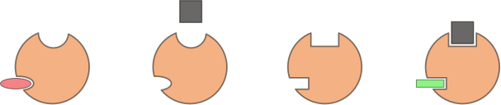
How does feedback inhibition occur?
Feedback inhibition often uses the immediate product of the reaction (product inhibition), but can also use downstream products. How?
Inhibitors: (Competitive, uncompetitive, mixed)
Allosteric inhibitors and activators
ligand
ligand
Allosteric activator
Allosteric inhibitor
“tense”
conformation
“relaxed”
conformation

Slide 8


Noncovalent Modification: Allosteric Regulators
  The kinetics of allosteric regulators differ from Michaelis & Menten kinetics.
  Remember Hemoglobin vs. Myoglobin?
$$V_{max}$$
Michaelis & Menten
Negative allostery
Sigmoidal shape, appears to modify Km
$$V_{o} (μM/min){}$$
[P] (mM)

Slide 9
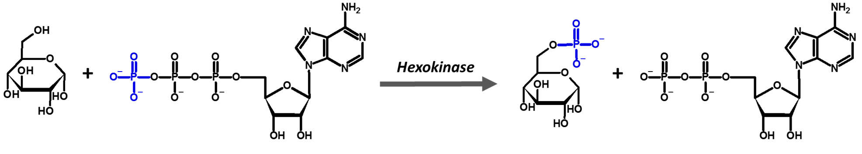
Use Hexokinase as an example
A
B
Glycolysis
ATP
C
Glucose
ATP
Glucose-6-P
ADP
Pyruvate
D
E

Slide 10
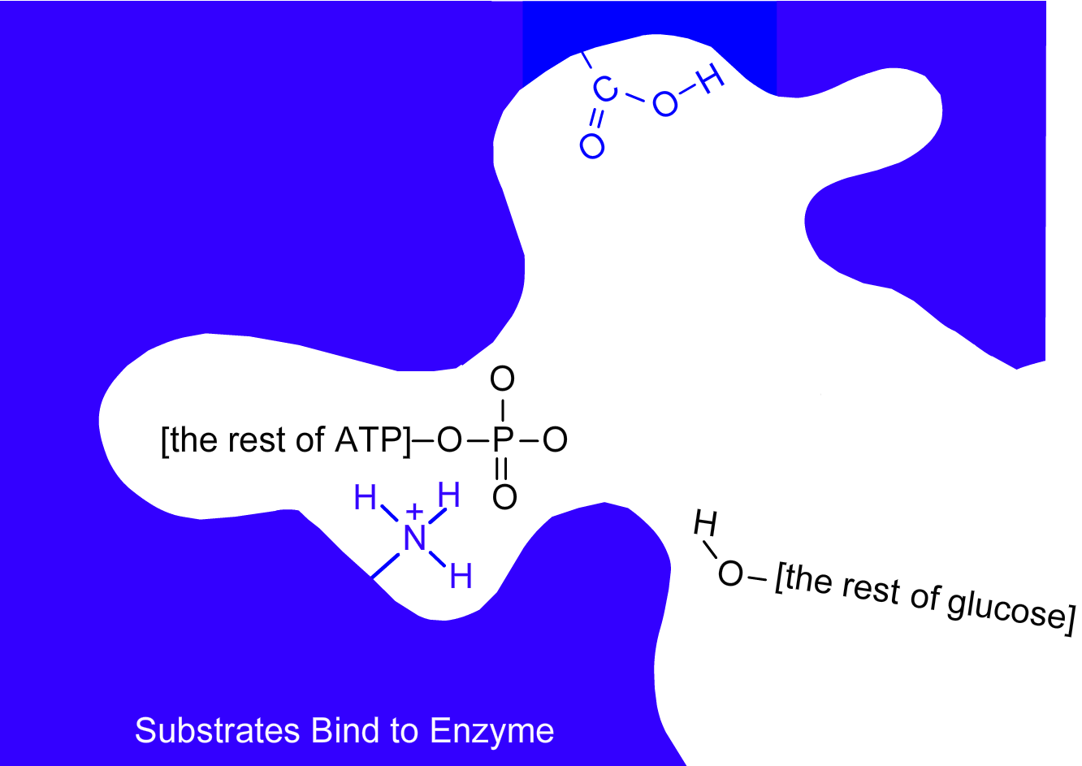
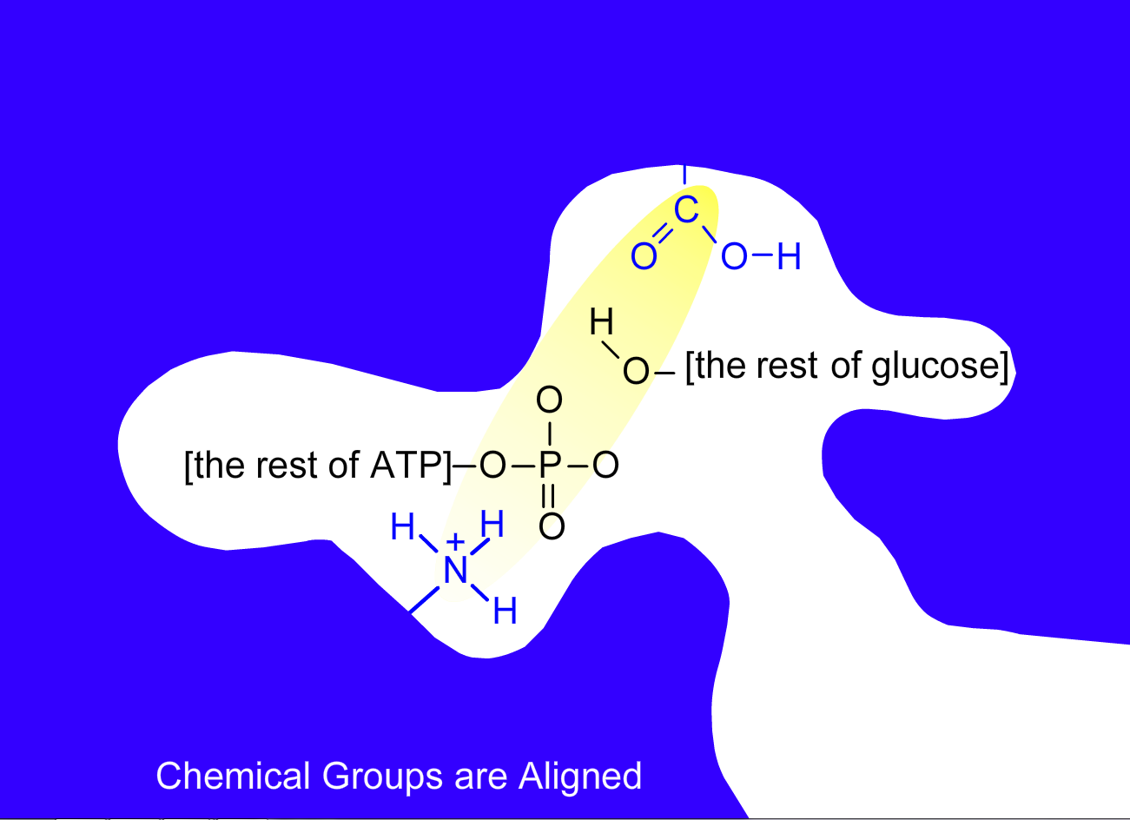
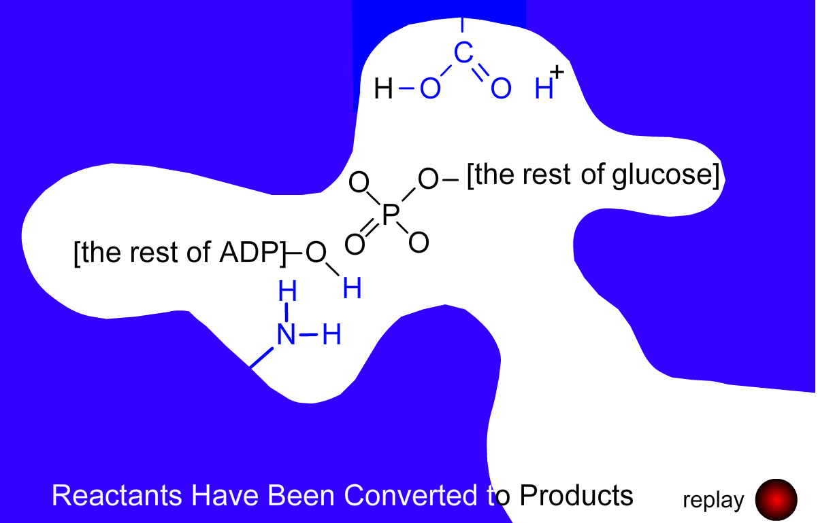
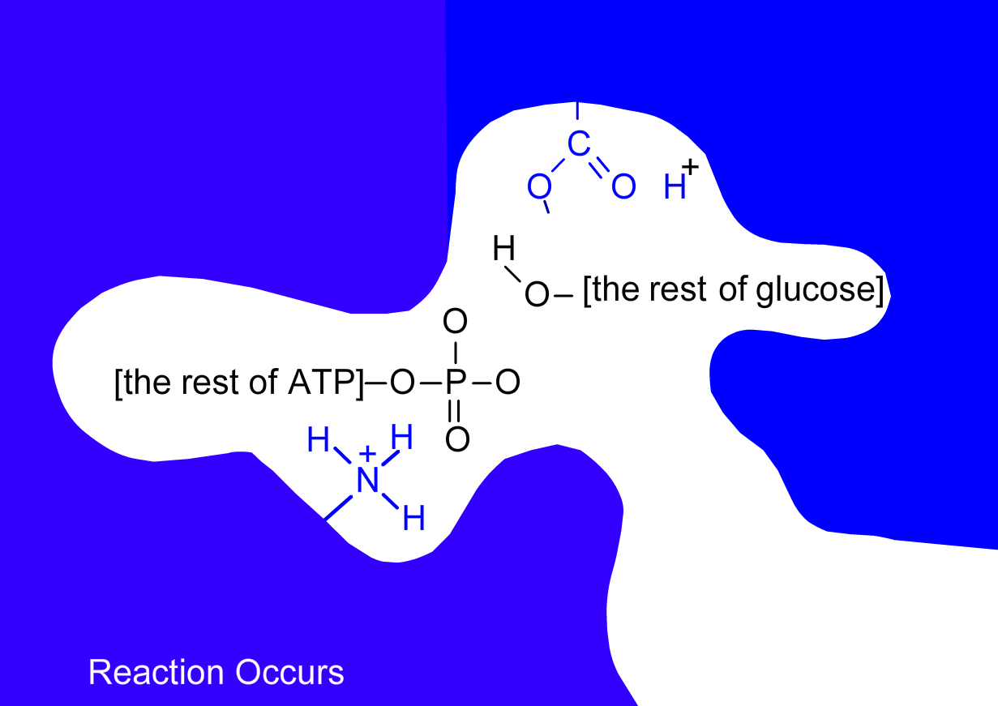
EC2. Transferase: Hexokinase mechanism
http://www.indiana.edu/~oso/animations/hexokinase.html
Cage effect: binding two substrates in the correct orientation.
Acid-base: give and take protons from/to substrate.

Slide 11
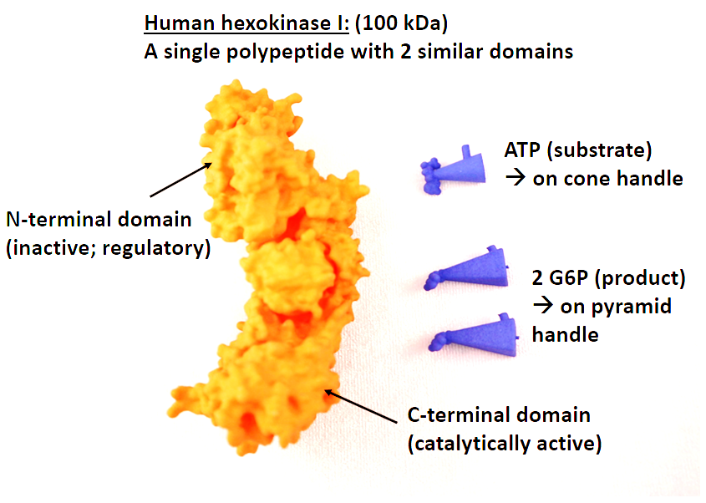
Discovering enzyme regulation with 3D models

Slide 12
Clicker Question
How does Glucose-6-phosphate regulate hexokinase I?
Competition for active site
Back reaction
Allostery
A and B
A, B, and C

Slide 13
Clicker Question
Which of the following represent the activity of hexokinase I when Glucose-6-phosphate is present?
A
B
C

Slide 14
Summary: Internal Regulation of Enzymes
  Within the body, enzymes are regulated by noncovalent or covalent modification, which can be reversible or irreversible at the protein level.
  Common modifications include: allosteric regulators (especially feedback inhibitors), phosphorylation, alkylation, ubiquitination, and hydrophobic group addition/removal.
  The cell can also alter conditions of small molecules (pH!) and cofactor requirements (Ca⁺⁺) to modulate enzyme activity.
A
B
C
D
E

